Slide 1
ASP.Net Core – Your first application
Kamal Beydoun
Lebanese University – Faculty of Sciences I
Kamal.beydoun@ul.edu.lb
Notes:
TIP You can view the application code for this chapter in the GitHub repository for the book at https://github.com/andrewlock/asp-dot-net-core-in-action. Once you’ve created your application, I’ll show you how to restore all the necessary dependencies, compile your application, and run it to see the HTML output. The application will be simple in some respects—it will only have three different pages—but it’ll be a fully configured ASP.NET Core application.

Slide 2
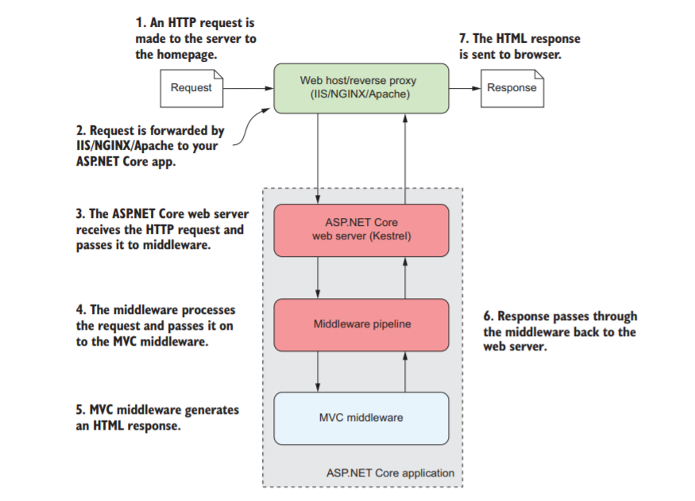
A brief overview of an ASP.NET Core application
The HttpContext constructed by the ASP.NET Core web server is used by the application as a sort of storage box for a single request. Anything that’s specific to this particular request and the subsequent response can be associated with it and stored in it.
This could include properties of the request, request-specific services, data that’s been loaded, or errors that have occurred.
The web server fills the initial HttpContext with details of the original HTTP request and other configuration details and passes it on to the rest of the application.
Notes:
The first port of call after the reverse proxy forwards a request is the ASP.NET Core web server, which is the default cross-platform Kestrel server. Kestrel takes the raw incoming request and uses it to generate an HttpContext object the rest of the application can use.
Kestrel isn’t the only HTTP server available in ASP.NET Core, but it’s the most performant and is cross-platform. I’ll only refer to Kestrel throughout the book. The main alternative, HTTP.sys, only runs on Windows and can’t be used with IIS.

Slide 3
A brief overview of an ASP.NET Core application
Kestrel is responsible for receiving the request data and constructing a C# representation of the request, but it doesn’t attempt to handle the request directly.
Kestrel hands the HttpContext to the middleware pipeline found in every ASP.NET Core application.
Notes:
The first port of call after the reverse proxy forwards a request is the ASP.NET Core web server, which is the default cross-platform Kestrel server.
Kestrel takes the raw incoming request and uses it to generate an HttpContext object the rest of the application can use.
Kestrel isn’t the only HTTP server available in ASP.NET Core, but it’s the most performant and is cross-platform. I’ll only refer to Kestrel throughout the book. The main alternative, HTTP.sys, only runs on Windows and can’t be used with IIS.
Middleware pipeline : This is a series of components that processes the incoming request to perform common operations such as logging, handling exceptions, or serving static files.

Slide 4
A brief overview of an ASP.NET Core application
MVC block: responsible for generating the HTML that makes up the pages of a typical ASP.NET Core web app.
most of the business logic of your app
Not every app needs an MVC block, but it’s typically how you’ll build most apps that display HTML to a user.
Notes:
The first port of call after the reverse proxy forwards a request is the ASP.NET Core web server, which is the default cross-platform Kestrel server. Kestrel takes the raw incoming request and uses it to generate an HttpContext object the rest of the application can use.
Kestrel isn’t the only HTTP server available in ASP.NET Core, but it’s the most performant and is cross-platform. I’ll only refer to Kestrel throughout the book. The main alternative, HTTP.sys, only runs on Windows and can’t be used with IIS.

Slide 5
Creating your first ASP.NET Core application
Generate—Create the base application from a template to get started.
Restore—Restore all the packages and dependencies to the local project folder using NuGet.
Build—Compile the application and generate all the necessary assets.
Run—Run the compiled application.
Notes:
This chapter uses Visual Studio 2017 and ASP.NET Core 2.0.

Slide 6
Create an App with VS
To create your first web application, open Visual Studio and perform the following steps:
Choose File > New > Project.
From the Templates node on the left, choose .NET Core, and then select ASP.NET Core Web Application.
Enter a Name, Location, and a solution name (optional) and click OK
Select ASP.NET Core 2.0.
The generated application will target ASP.NET Core 2.0.
Select Web Application (Model-View-Controller).

Slide 7
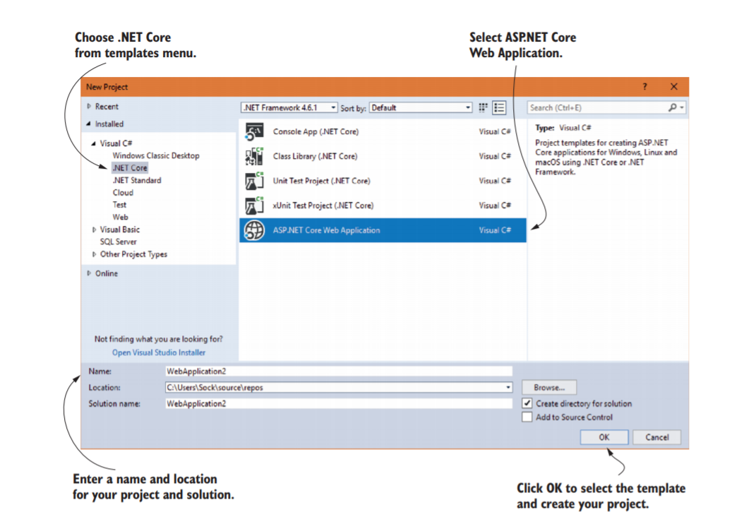
Create an App with VS

Slide 8
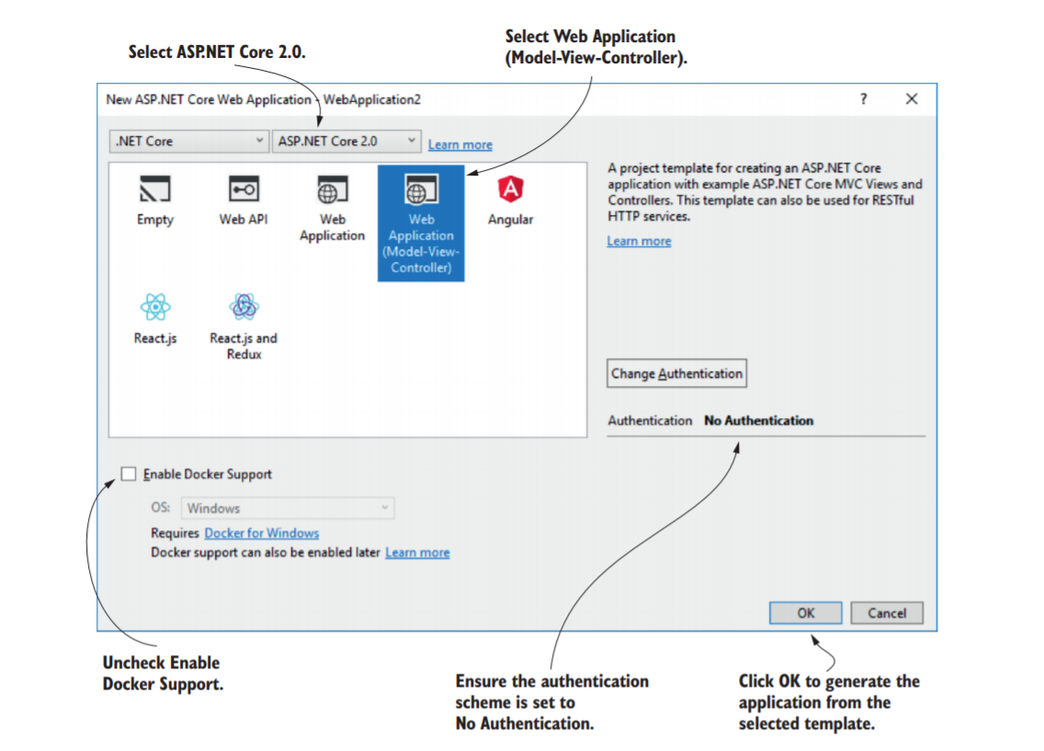
Create an App with VS
If you’re developing using the .NET CLI, you can create a similar application by running
dotnet new mvc –o WebApplication2
from the command line.
The -o argument ensures the CLI creates the template in a subfolder called WebApplication2.
Notes:
This ensures you create a traditional web application that generates HTML and is designed to be viewed by users in a web browser directly. The other web application template uses the new Razor Pages2 functionality of ASP.NET Core 2.0. The Web API template generates an application that returns data in a format that can be consumed by single-page applications (SPAs) and APIs. The Angular, React.js, and React.js and Redux templates create applications for specific SPAs. Ensure No Authentication is specified. You’ll learn how to add users to your app in chapter 14. Ensure Enable Docker Support is unchecked. Click OK.

Slide 9
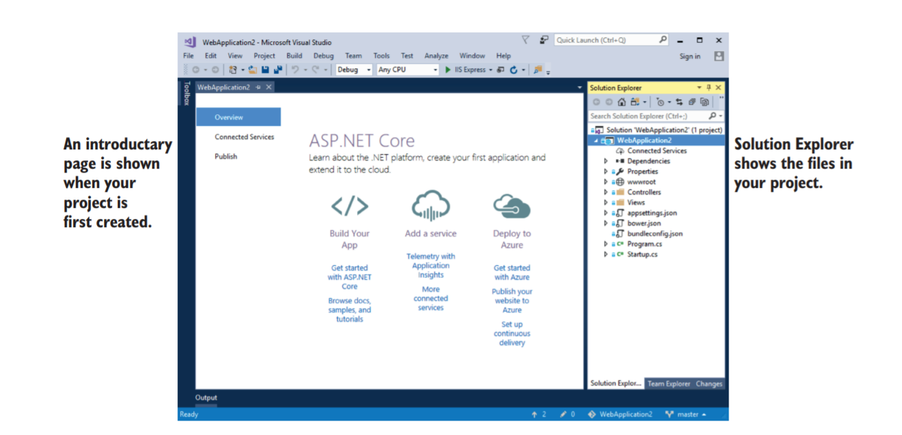
Create an App with VS

Slide 10
Building the application
Both Visual Studio and the .NET CLI automatically restore packages when they first create your project
In earlier versions you needed to manually
restore packages using dotnet restore.
You can compile your application by choosing Build > Build Solution, by using the shortcut Ctrl+Shift+B, or by running
dotnet build
from the command line.

Slide 11
.NET Core Command Line Interface (CLI)
One of the foundational components of .NET Core cross-platform development
The most common commands during development are
dotnet restore
dotnet build
dotnet run
Each of these commands should be run inside your project folder and will act on that project alone.
dotnet restore, will ensure your application’s NuGet dependencies are copied to your project folder.
You can compile your application using dotnet build.
if there are no issues, will produce an output that can be run using dotnet run.

Slide 12
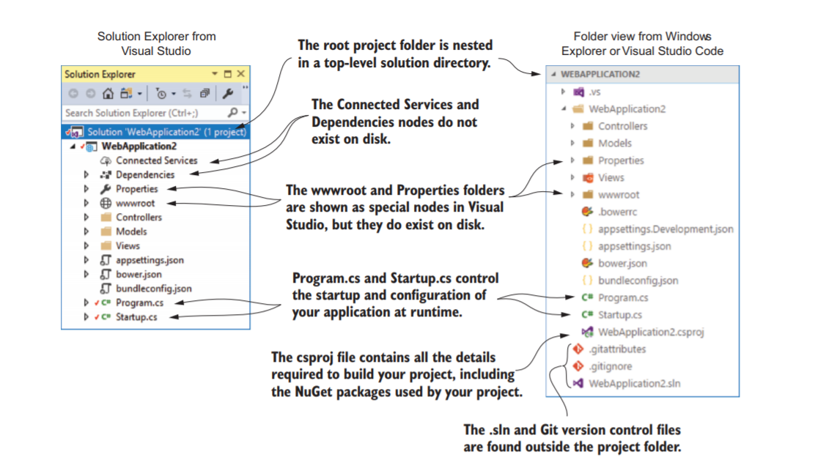
Understanding the project layout
Bower is no longer supported, and so the ASP.NET team are exploring alternatives to fulfill this role. Bower is a client-side asset management system for obtaining CSS and JavaScript libraries.
Notes:
The first thing to notice is that the main project, WebApplication2, is nested in a top level directory with the name of the solution, also WebApplication2 in this case.
Within this top-level folder, you’ll also find the solution (.sln) file for use by Visual Studio and files related to Git version control,3 though these are hidden in Visual Studio’s Solution Explorer view.
NOTE Visual Studio uses the concept of a solution to work with multiple projects. The example solution only consists of a single project, which is listed in the .sln file.
Inside the solution folder, you’ll find your project folder, which in turn contains five subfolders—Models, Controllers, Views, Properties, and wwwroot.
Models, Controllers, and Views (unsurprisingly) contain the MVC Model, Controller, and View files you’ll use to build your application.
The Properties folder contains a single file, launchSettings.json, which controls how Visual Studio will run and debug the application.
The wwwroot folder is special, in that it’s the only folder in your application that browsers are allowed to directly access when browsing your web app. You can store your CSS, JavaScript, images, or static HTML files in here and browsers will be able to access them. They won’t be able to access any file that lives outside of wwwroot.
You’ve got two more special nodes in the project, Dependencies and Connected Services, but they don’t have a corresponding folder on disk. Instead, they show a collection of all the dependencies, such as NuGet packages, client-side dependencies, and remote services that the project relies on.
In the root of your project folder, you’ll find several JSON files, such as appsettings .json, bundleconfig.json, and bower.json. These provide various configuration settings, some of which are used at runtime, and others which are used to build your app at compile time.

Slide 13
csproj project file : project layout
It contains the details required for the .NET tooling to build your project.
It defines the type of project being built (web app, console app, or library), which platform the project targets (.NET Core, .NET Framework 4.5, Mono, and so on), and which NuGet packages the project depends on.

Slide 14
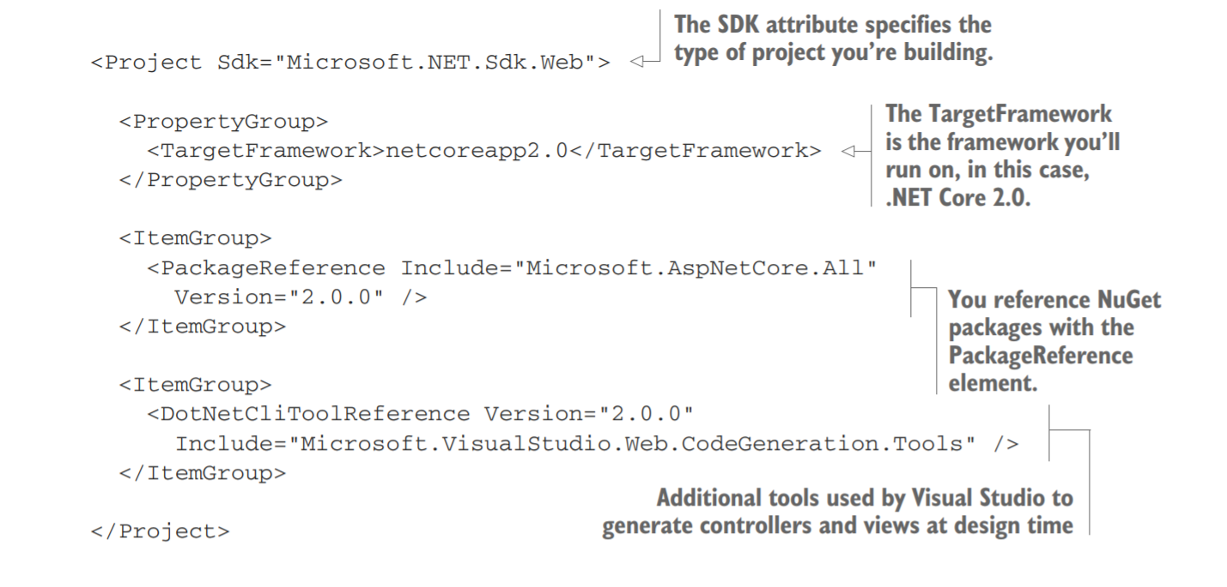
Understanding the project layout
Notes:
The most common changes you’ll make to the project file are to add additional NuGet packages using the PackageReference element.
By default, your app references a single NuGet package, Microsoft.AspNetCore.All. This is a metapackage that includes all of the packages associated with ASP.NET Core 2.0. It’s only available when you’re targeting .NET Core, but it means you don’t have to reference each individual ASP.NET Core package.
A metapackage is a NuGet package that contains no code, referencing one or more other NuGet packages instead.
By adding the metapackage to your app, you can conveniently and implicitly add all of the packages it references. In ASP.NET Core 2.1, the Microsoft.AspNetCore.App metapackage package is referenced by default instead. You can read about the difference between the App and All metapackages at https://github.com/aspnet/ Announcements/issues/287.

Slide 15
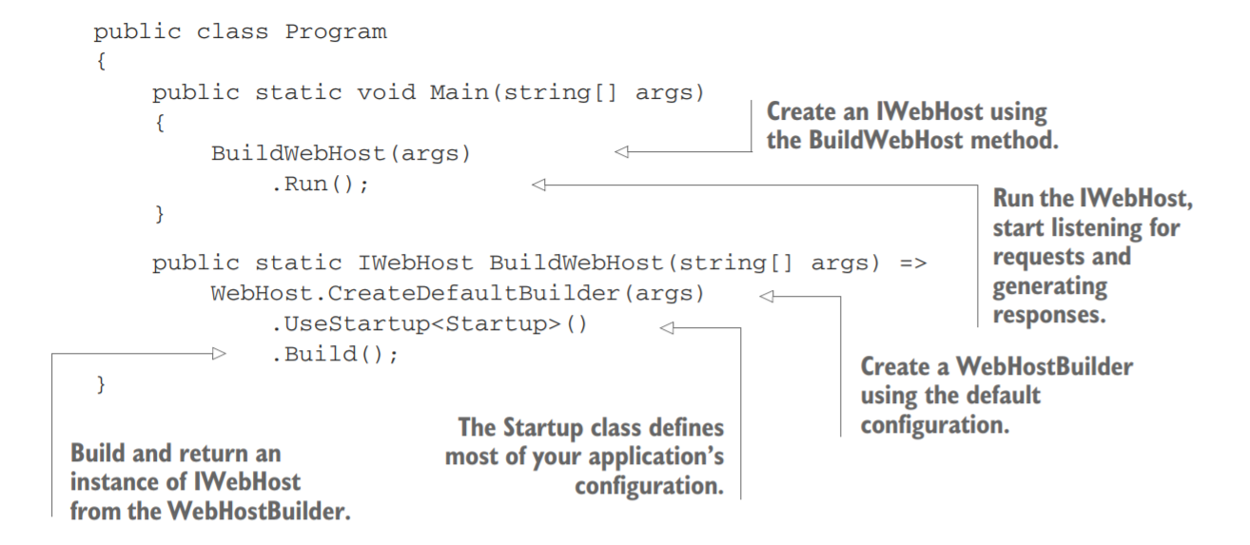
The Program class: building a web host
The IWebHost is the core of your ASP.NET Core application, containing the application configuration and the Kestrel server that listens for requests and sends responses.
Notes:
All ASP.NET Core applications start in the same way as .NET Console applications—with a Program.cs file. This file contains a static void Main function, which is a standard characteristic of console apps.
The IWebHost is the core of your ASP.NET Core application, containing the application configuration and the Kestrel server that listens for requests and sends responses.
The Main function contains all the basic initialization code required to create a web server and to start listening for requests. It uses a WebHostBuilder, created by the call to CreateDefaultBuilder, to define how the IWebHost is configured, before instantiating the IWebHost with a call to Build( ).
The Program class for two different ASP.NET Core applications will generally be similar, but the Startup classes will often differ significantly (though they generally follow a similar pattern, as you’ll see shortly). You’ll rarely find that you need to modify Program as your application grows, whereas you’ll normally update Startup whenever you add additional features.
The CreateDefaultBuilder method is a static helper method, introduced in ASP.NET Core 2.0, to simplify the bootstrapping of your app by creating a WebHostBuilder with some common configuration.
Once the configuration of the WebHostBuilder is complete, the call to Build produces the IWebHost instance, but the application still isn’t handling HTTP requests yet.
It’s the call to Run that starts the HTTP server listening. At this point, your application is fully operational and can respond to its first request from a remote browser.
Much of your app’s configuration takes place in the WebHostBuilder created by the call to CreateDefaultBuilder, but it delegates some responsibility to a separate class, Startup.

Slide 16
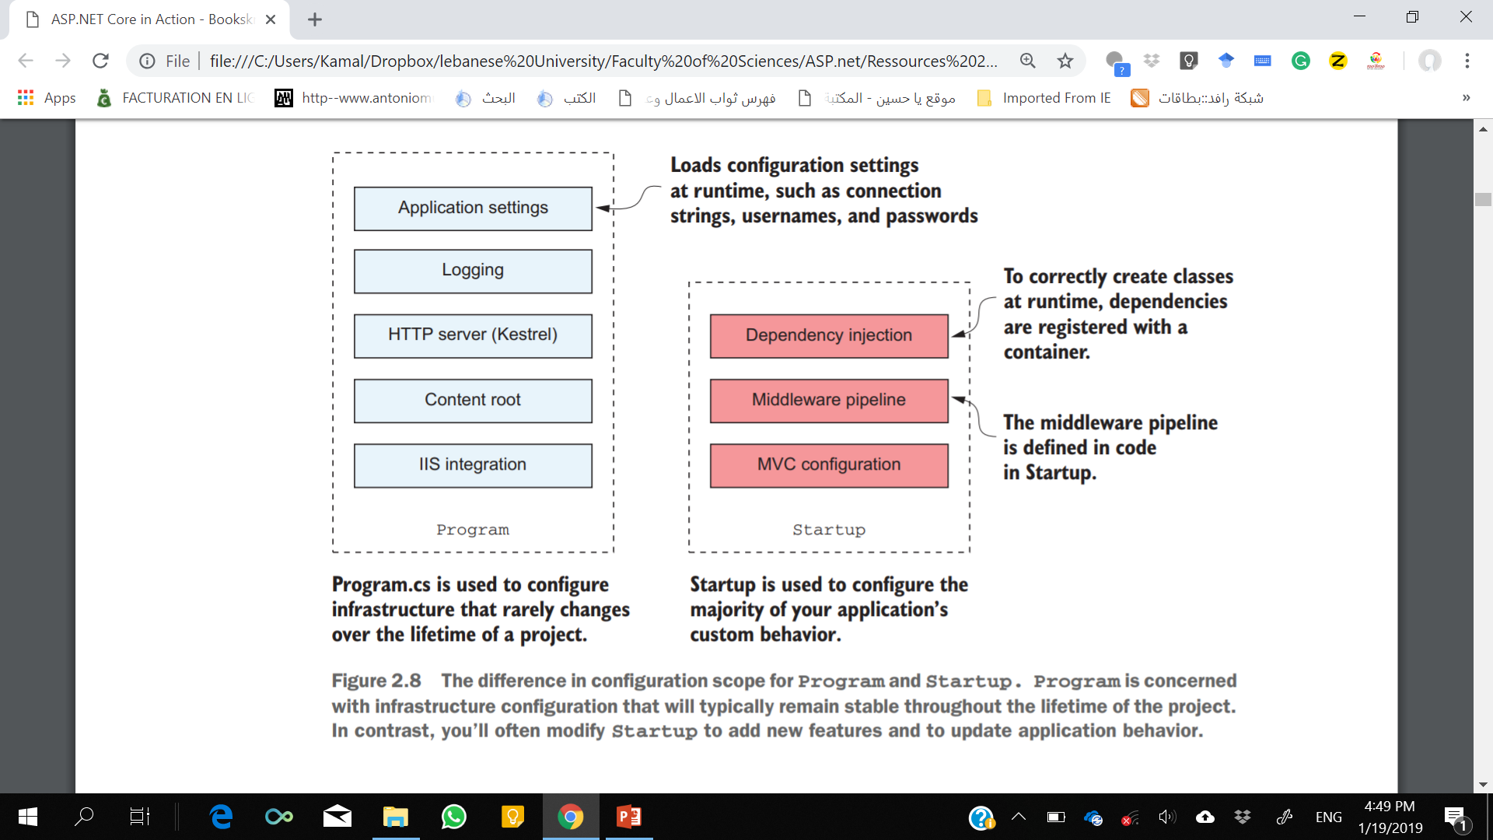
Program Class vs Startup class

Slide 17
The Startup class: configuring your application
The Startup class is responsible for configuring two main aspects of your application:
Service registration —Any classes that your application depends on for providing functionality—both those used by the framework and those specific to your application—must be registered so that they can be correctly instantiated at runtime.
Middleware and MVC —How your application handles and responds to requests.

Slide 18
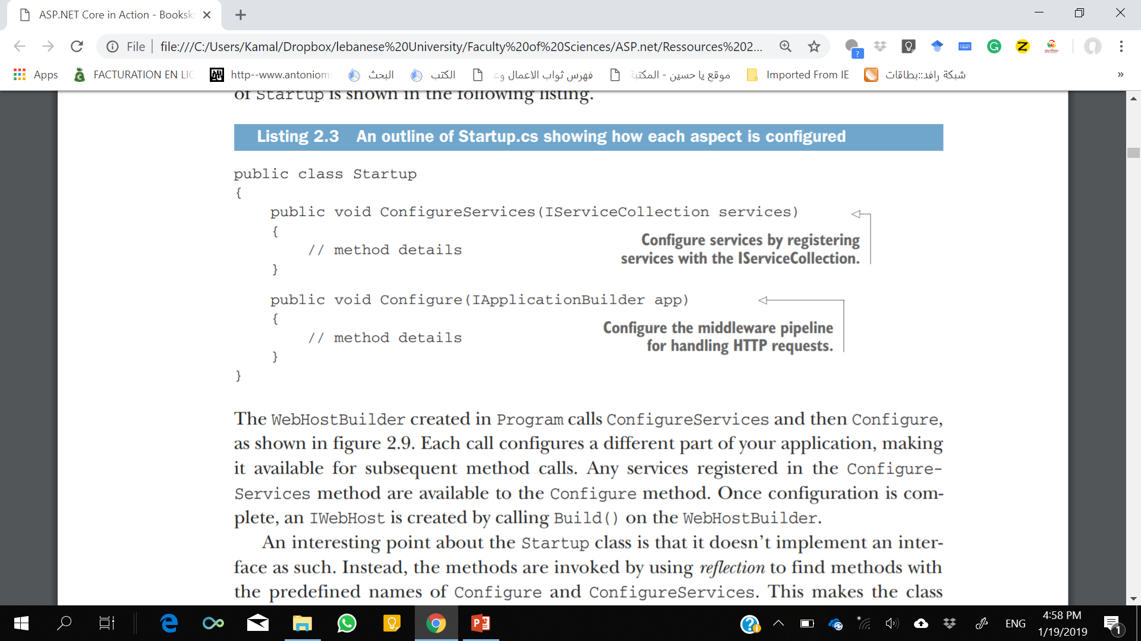
The Startup class: configuring your application
The WebHostBuilder created in Program calls ConfigureServices and then Configure.
Any services registered in the ConfigureServices method are available to the Configure method.
Notes:
Each call configures a different part of your application, making it available for subsequent method calls.
Any services registered in the ConfigureServices method are available to the Configure method. Once configuration is complete, an IWebHost is created by calling Build() on the WebHostBuilder.

Slide 19
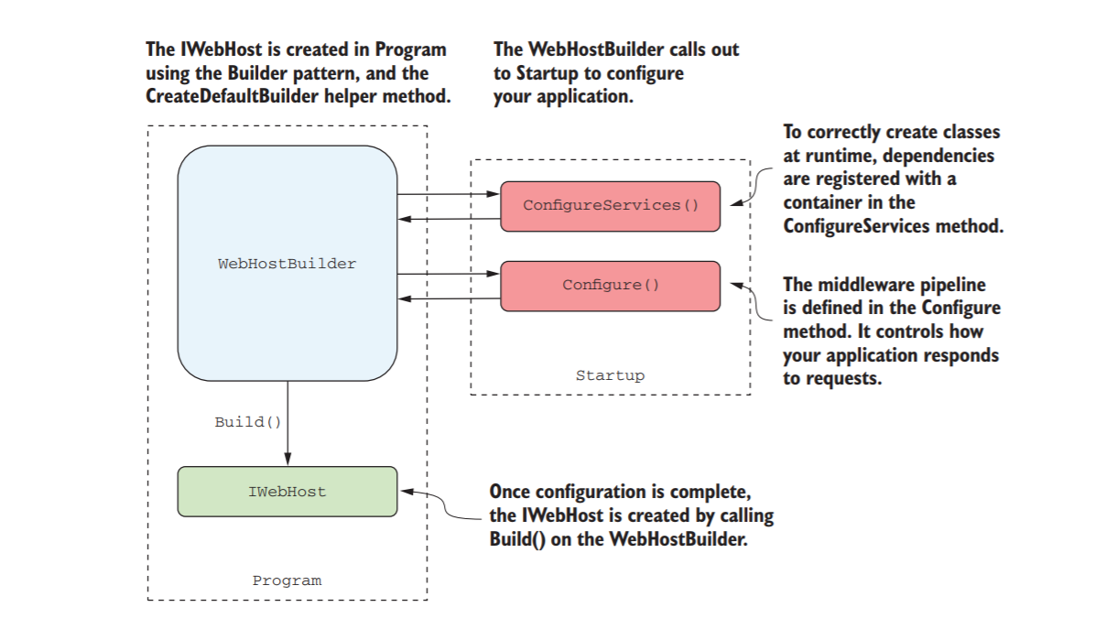
The Startup class: configuring your application
Notes:
The WebHostBuilder created in Program calls ConfigureServices and then Configure.
Each call configures a different part of your application, making it available for subsequent method calls. Any services registered in the ConfigureServices method are available to the Configure method. Once configuration is complete, an IWebHost is created by calling Build() on the WebHostBuilder.
----------------------
An interesting point about the Startup class is that it doesn’t implement an interface as such. Instead, the methods are invoked by using reflection to find methods with the predefined names of Configure and ConfigureServices. This makes the class more flexible and enables you to modify the signature of the method to accept additional parameters that are fulfilled automatically. I’ll cover how this works in detail in chapter 10, for now it’s enough to know that anything that’s configured in ConfigureServices can be accessed by the Configure method.

Slide 20
Adding and configuring services
ASP.NET Core uses small, modular components for each distinct feature.
exposed as one or more services that are used by the application.
service refers to any class that provides functionality to an application
service could be classes exposed by a library or code you’ve written for your application.
The single responsibility principle (SRP) states that every class should be responsible for only a single piece of functionality—it should only need to change if that required functionality changes.
You must register each service with the “container” before it can be used in your application.
Notes:
you might have a ShippingCostService that calculates the cost of shipping to a user’s location.
The OrderTotalCalculatorService needs access to an instance of ShippingCostService and TaxCalculator. A naïve approach to this problem is to use the new keyword and create an instance of a service whenever you need it. Unfortunately, this tightly couples your code to the specific implementation you’re using and can completely undo all the good work achieved by modularizing the features in the first place. In some cases, it may break the SRP by making you perform initialization code as well as using the service you created.
One solution to this problem is to make it somebody else’s problem. When writing a service, you can declare your dependencies and let another class fill those dependencies for you. Your service can then focus on the functionality for which it was designed, instead of trying to work out how to build its dependencies. This technique is called dependency injection or the inversion of control (IoC) principle and is a well-recognized design pattern that is used extensively.

Slide 21
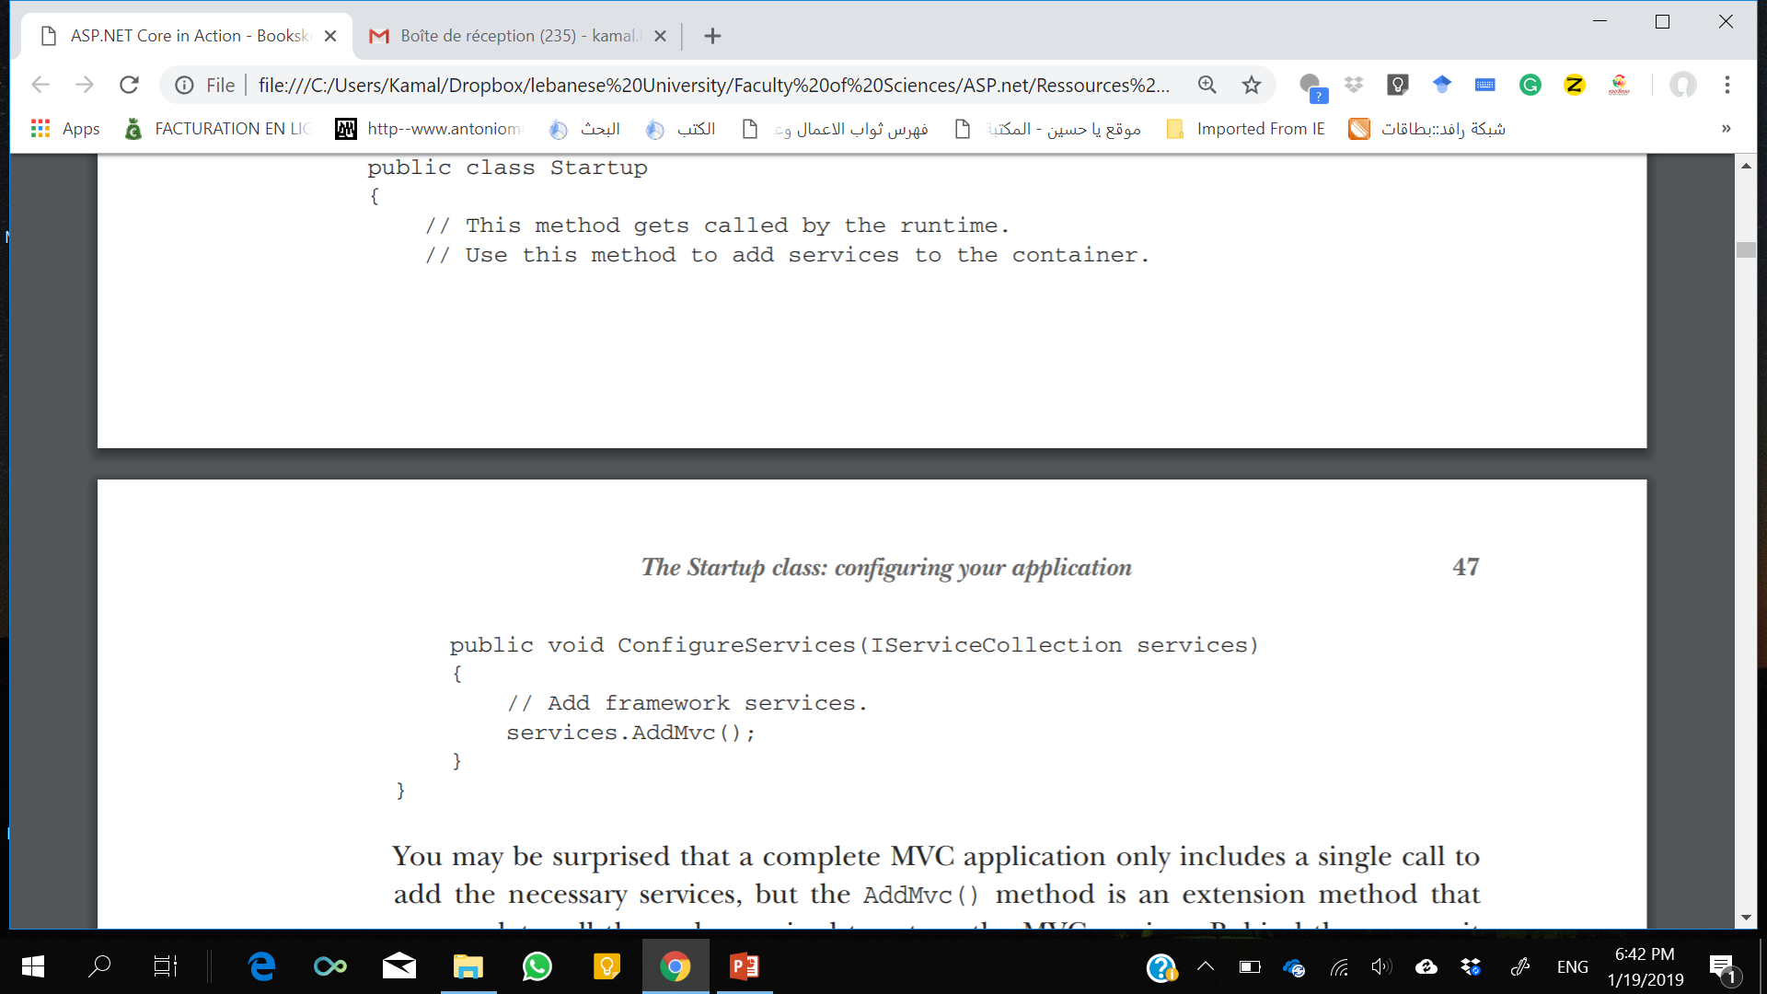
Adding and configuring services
As well as registering framework-related services, this method is where you’d register any custom services you have in your application.
The IServiceCollection is a list of every known service that your application will need to use.
By adding a new service to it, you ensure that whenever a class declares a dependency on your service, the IoC container (dependency Injection) knows how to provide it.
Notes:
In an ASP.NET Core application, this registration is performed in the Configure-Services method. Whenever you use a new ASP.NET Core feature in your application, you’ll need to come back to this method and add in the necessary services. This is not as arduous as it sounds, as shown here, taken from the example application.
I’ll describe the dependency inversion principle and the IoC (Inversion of Control) container used in ASP.NET Core in detail in chapter 10. Page 46

Slide 22
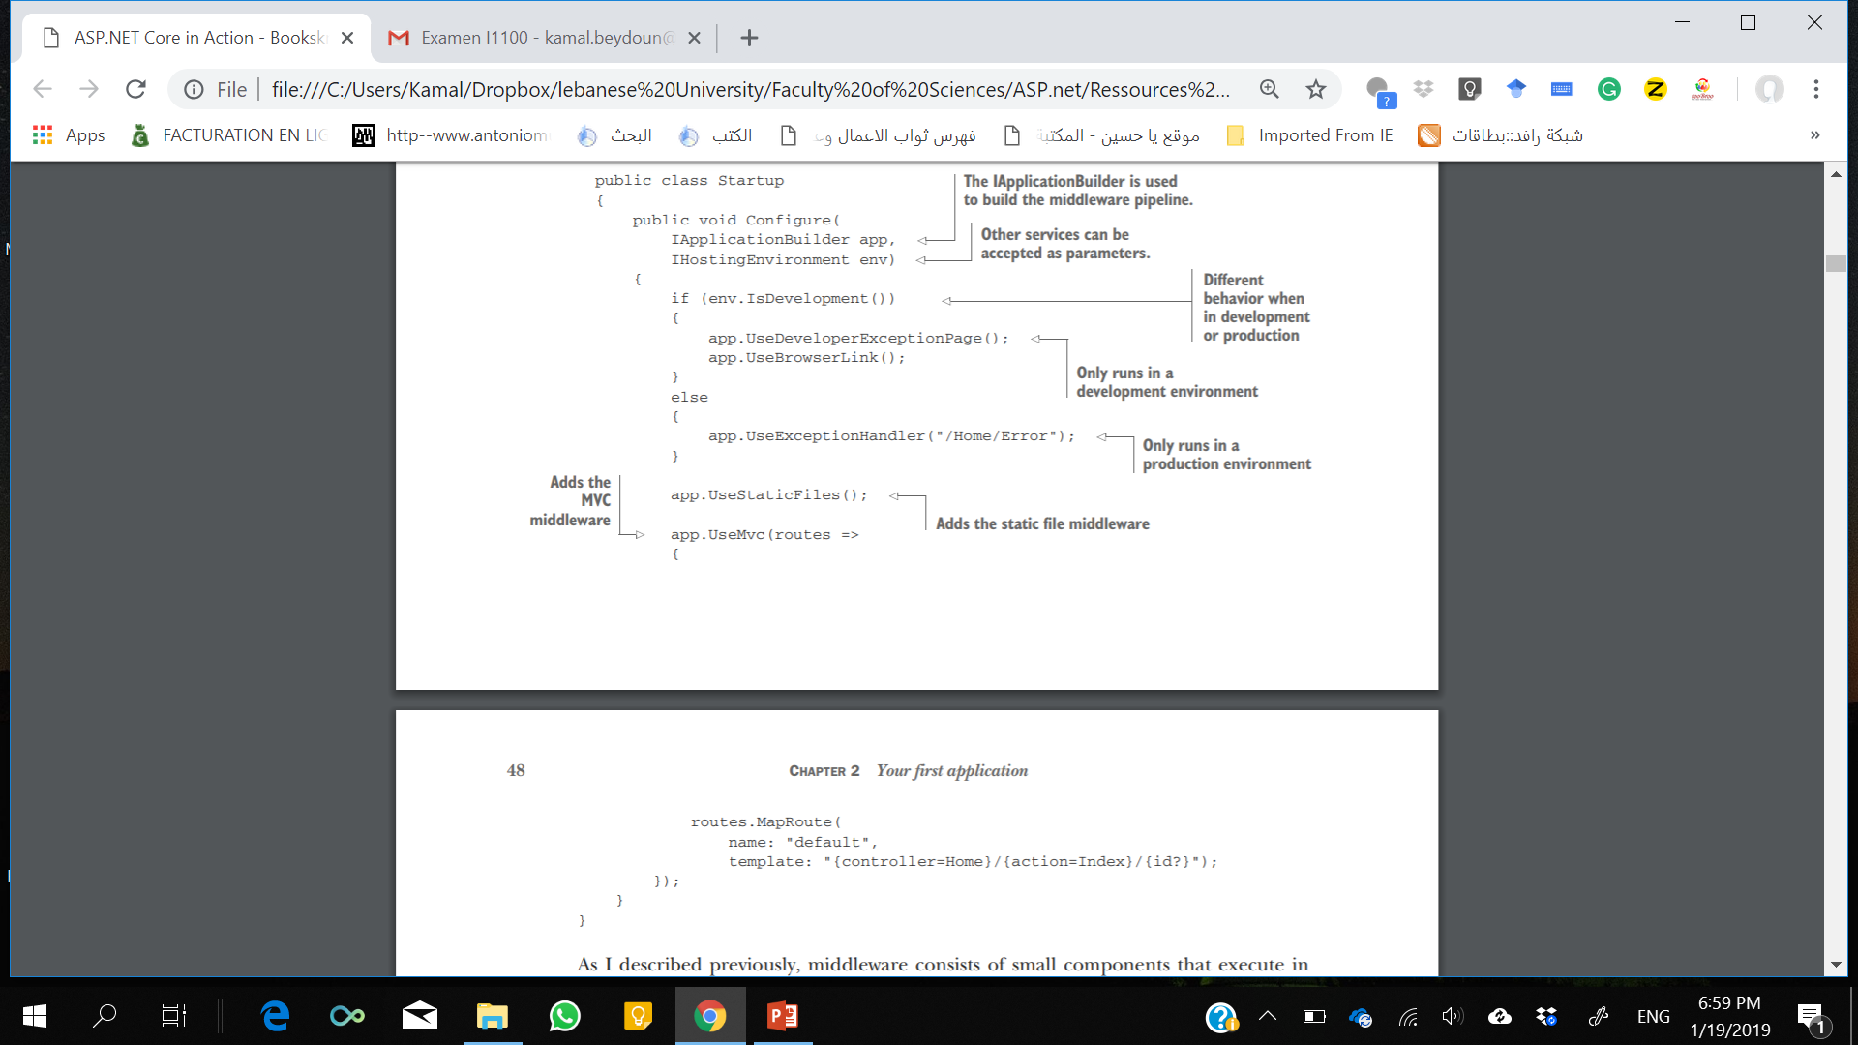
Defining how requests are handled with middleware
In Configure method, you define the middleware pipeline for the application
defines the app’s behavior.
IApplicationBuilder is used to define the order in which middleware executes.
IHostingEnvironment parameter is used to provide different behavior when you’re in a development environment.
Notes:
The IApplicationBuilder that’s passed to the Configure method is used to define the order in which middleware executes.
The order of the calls in this method is important, as the order they’re added to the builder in is the order they’ll execute in the final pipeline. Middleware can only use objects created by previous middleware in the pipeline—it can’t access objects created by later middleware. If you’re performing authorization in middleware to restrict the users that may access your application, you must ensure it comes after the authentication middleware that identifies the current user.
You should also note that an IHostingEnvironment parameter is used to provide different behavior when you’re in a development environment.

Slide 23
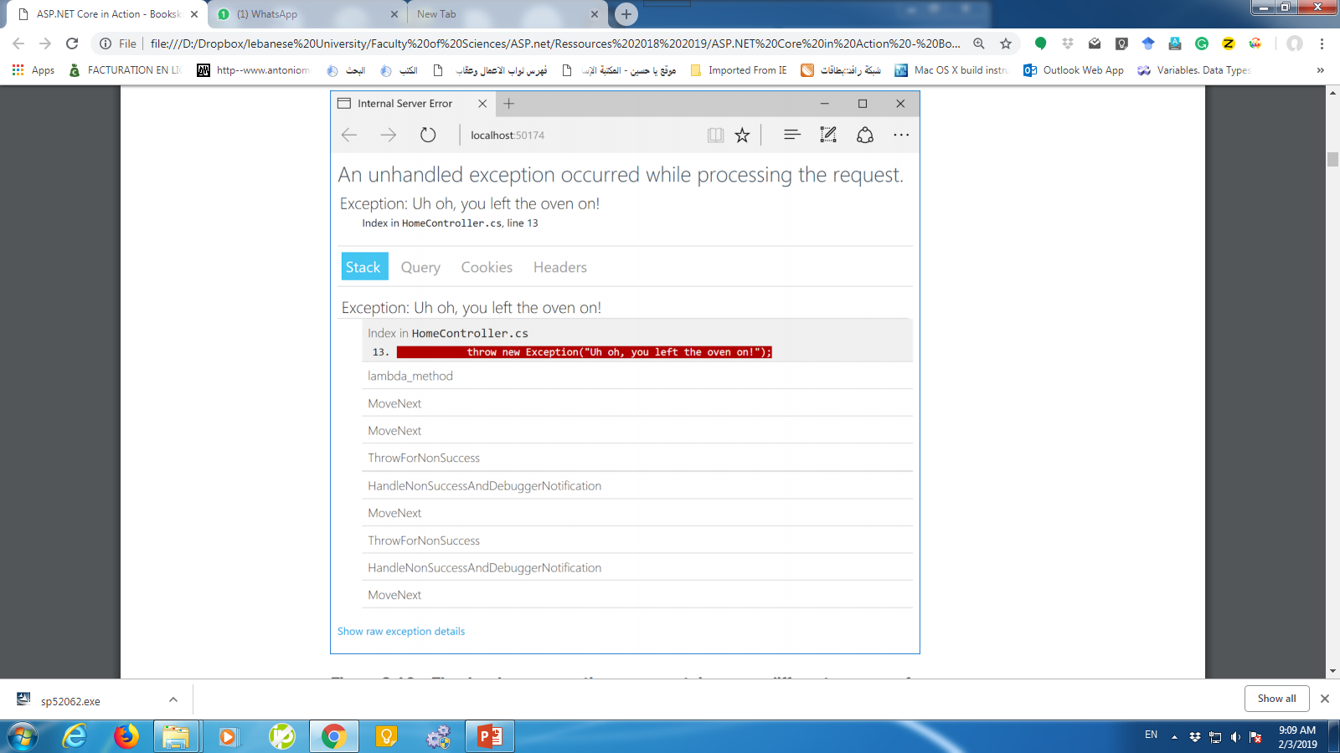
Exception Page
DeveloperExceptionPageMiddleware (added by the UseDeveloperExceptionPage() call) will be presented with as much information as possible in the browser

Slide 24
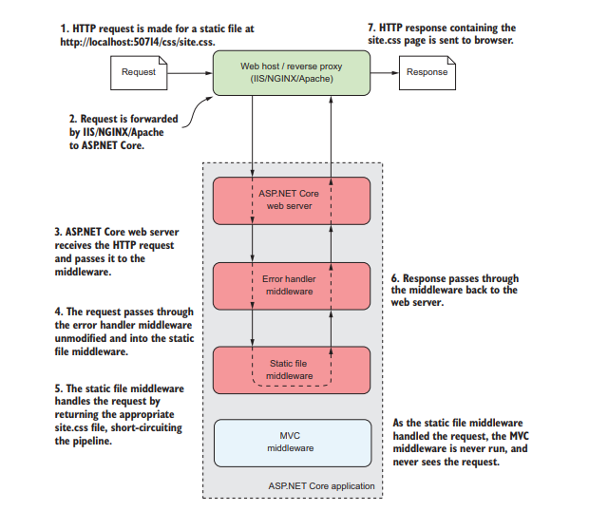
Static File Middleware
This middleware is responsible for handling requests for static files such as CSS files, JavaScript files, and images.
Notes:
The next piece of middleware added to the pipeline is StaticFileMiddleware, using this statement: app.UseStaticFiles();
When a request arrives at the middleware, it checks to see if the request is for an existing file. If it is, then the middleware returns the file. If not, the request is ignored and the next piece of middleware can attempt to handle the request.
When a request arrives at the middleware, it checks to see if the request is for an existing file. If it is, then the middleware returns the file. If not, the request is ignored and the next piece of middleware can attempt to handle the request. Figure 2.12 shows how the request is processed when a static file is requested. When the static-file middleware handles a request, other middleware that comes later in the pipeline, such as the MVC middleware, won’t be called at all.

Slide 25
MVC middleware and the home controller
MVC middleware will attempt to match a request’s path to a configured route
defines which controller and action method to invoke.
A path is the remainder of the request URL
for a request to www.microsoft.com/account/manage, the path is /account/manage.
An action is a method that runs in response to a request.
A controller is a class that contains a number of action methods that can be logically grouped.
Once the middleware has selected a controller and action for a given request, the appropriate class will be instantiated and the action method invoked.
Notes:
Once the middleware has selected a controller and action for a given request, the appropriate class will be instantiated and the action method invoked.

Slide 26
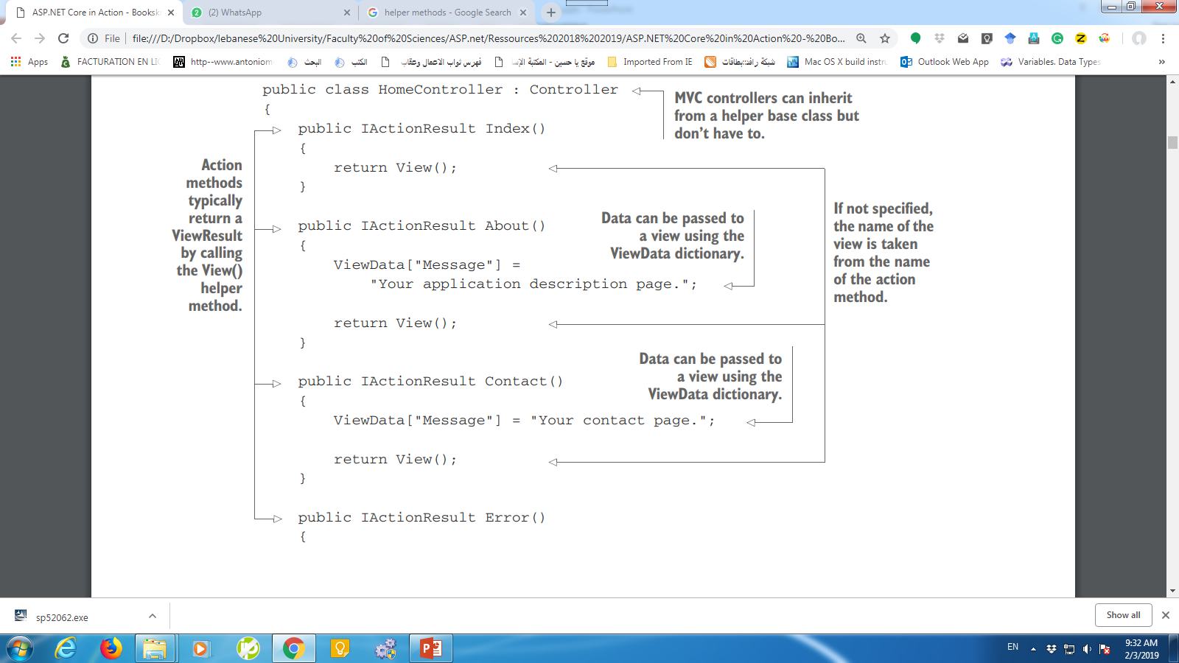
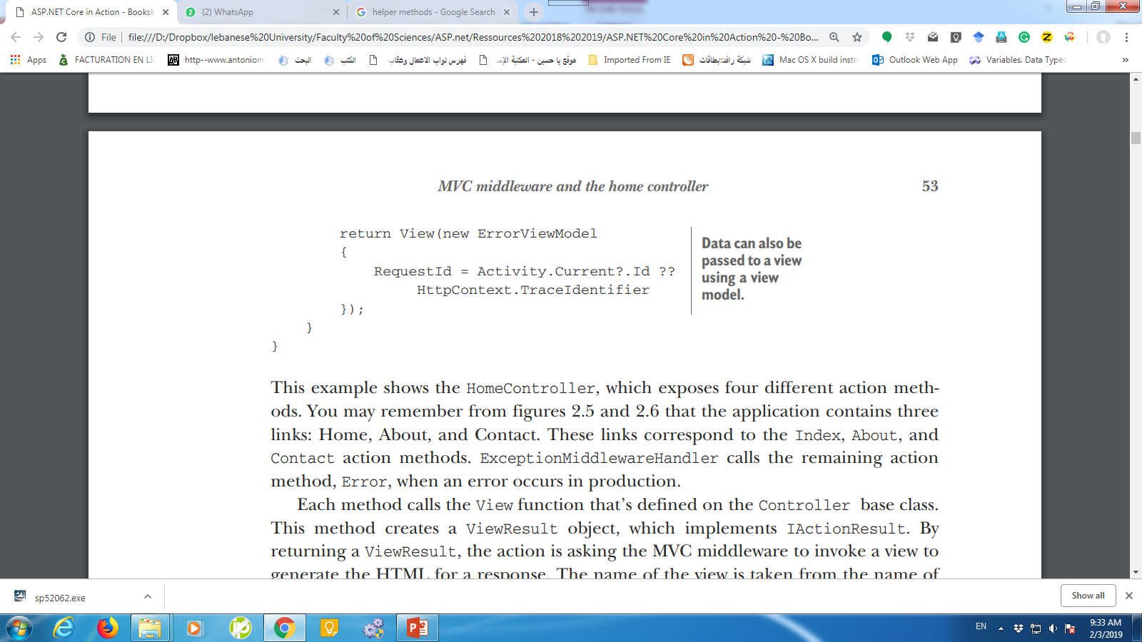
HomeController
The application contains three links: Home, About, and Contact.
correspond to the Index, About, and Contact action methods.
ExceptionMiddlewareHandler calls the remaining action method, Error, when an error occurs in production.
Notes:
This example shows the HomeController, which exposes four different action methods.
the application contains three links: Home, About, and Contact. These links correspond to the Index, About, and Contact action methods. ExceptionMiddlewareHandler calls the remaining action method, Error, when an error occurs in production.

Slide 27
HomeController
Each method calls the View function that’s defined on the Controller base class.
This method creates a ViewResult object, which implements IActionResult.
Notes:
Each method calls the View function that’s defined on the Controller base class. This method creates a ViewResult object, which implements IActionResult. By
returning a ViewResult, the action is asking the MVC middleware to invoke a view to generate the HTML for a response.
The name of the view is taken from the name of the action. So, in the case of the first action method, the view will be called Index.
As well as returning a ViewResult, the About and Contact action methods also set a value in the ViewData dictionary. This dictionary only lasts for the duration of the request and can be used to send arbitrary values to the view, which it can use when generating the HTML response.
The Error method uses a different approach to pass data from the controller to the view. A dedicated class, a view model, is created and passed to the View() method with data to display in the view.

Slide 28
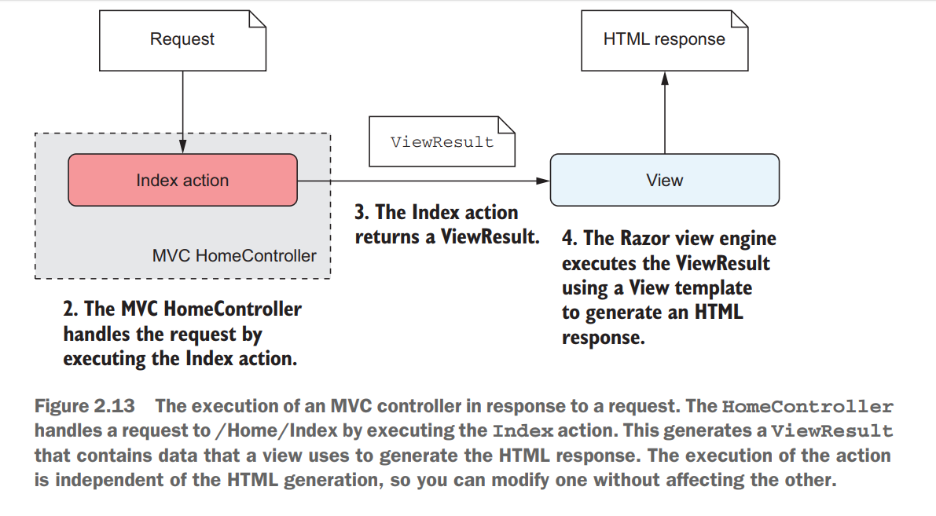
MVC Controller

Slide 29
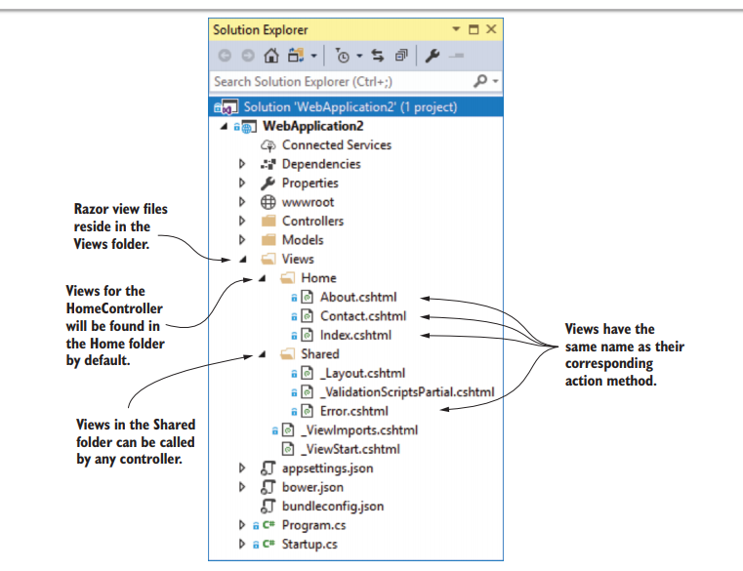
Generating HTML with Razor template views
Notes:
When an action method returns a ViewResult, it’s signaling to the MVC middleware that it should find a Razor template and generate the appropriate view. In the example, the action method doesn’t specify the name of the view to find, so the middleware attempts to find an appropriate file by using naming conventions.

Slide 30
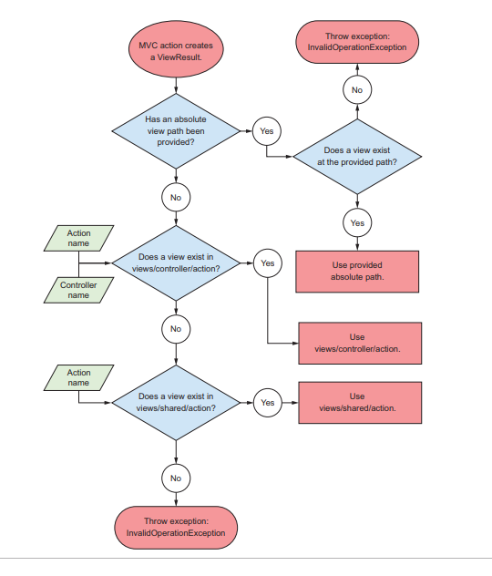
Notes:
Razor view templates are stored in cshtml files (a portmanteau of cs and html) within the Views folder of your project.
Generally, they’re named according to their associated actions, and reside in subfolders corresponding to the name of the controller. When a controller returns a ViewResult, the Razor engine attempts to locate the appropriate view template, as illustrated in figure 2.15.
For example, considering the HomeController you’ve already seen, the view template for the About action method can be found at Views\Home\About.cshtml, relative to the base project path.

Slide 31
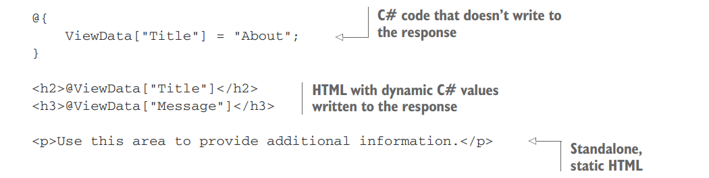
Razor Template
dynamically writing C# variables to the HTML stream using the @ symbol
Notes:
This file, although small, demonstrates three features of Razor that you can use when building your templates. The simplest and most obvious point is that standalone, static HTML is always valid in a template and will be rendered as is in the response.
Second, you can write ordinary C# code in Razor templates by using this construct @{ /* C# code here */ }
Any code between the curly braces will be executed but won’t be written to the response.
In the listing you’re setting the title of the page by writing a key to the ViewData dictionary, but you aren’t writing anything to the response at this point:
@{
ViewData["Title"] = "About";
}
Another feature shown in this template is dynamically writing C# variables to the HTML stream using the @ symbol. This ability to combine dynamic and static markup is what gives Razor templates their power.

Slide 32
